Slide 1

Contrails Detection System
By Denslin, Myron, & Sachi

Slide 2
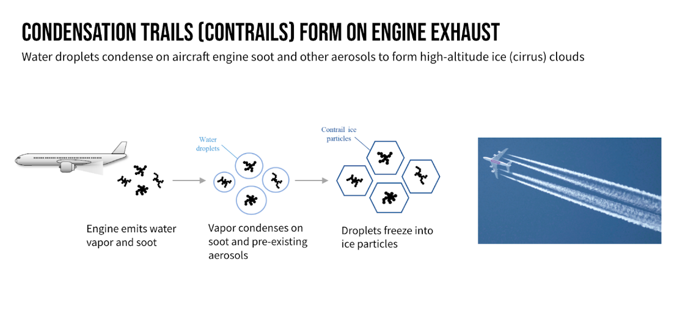

Slide 3
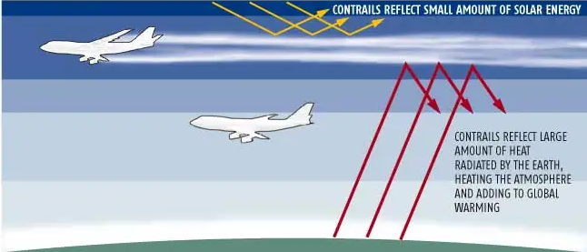
33,000 ft
25,000 ft

Slide 4
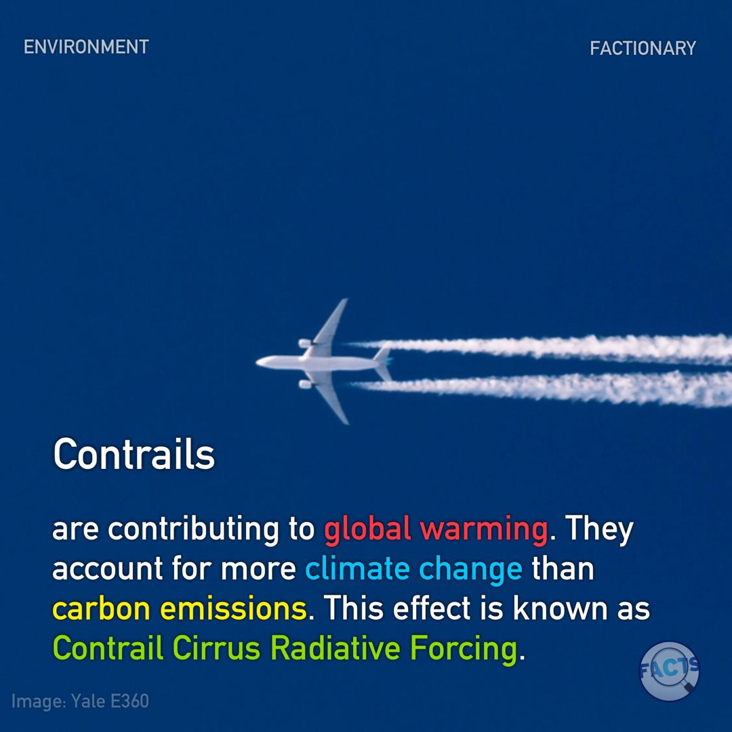
Contrails are Contributing 2.4%
in global warming
Increasing Night Temperature by 3°C

Slide 5
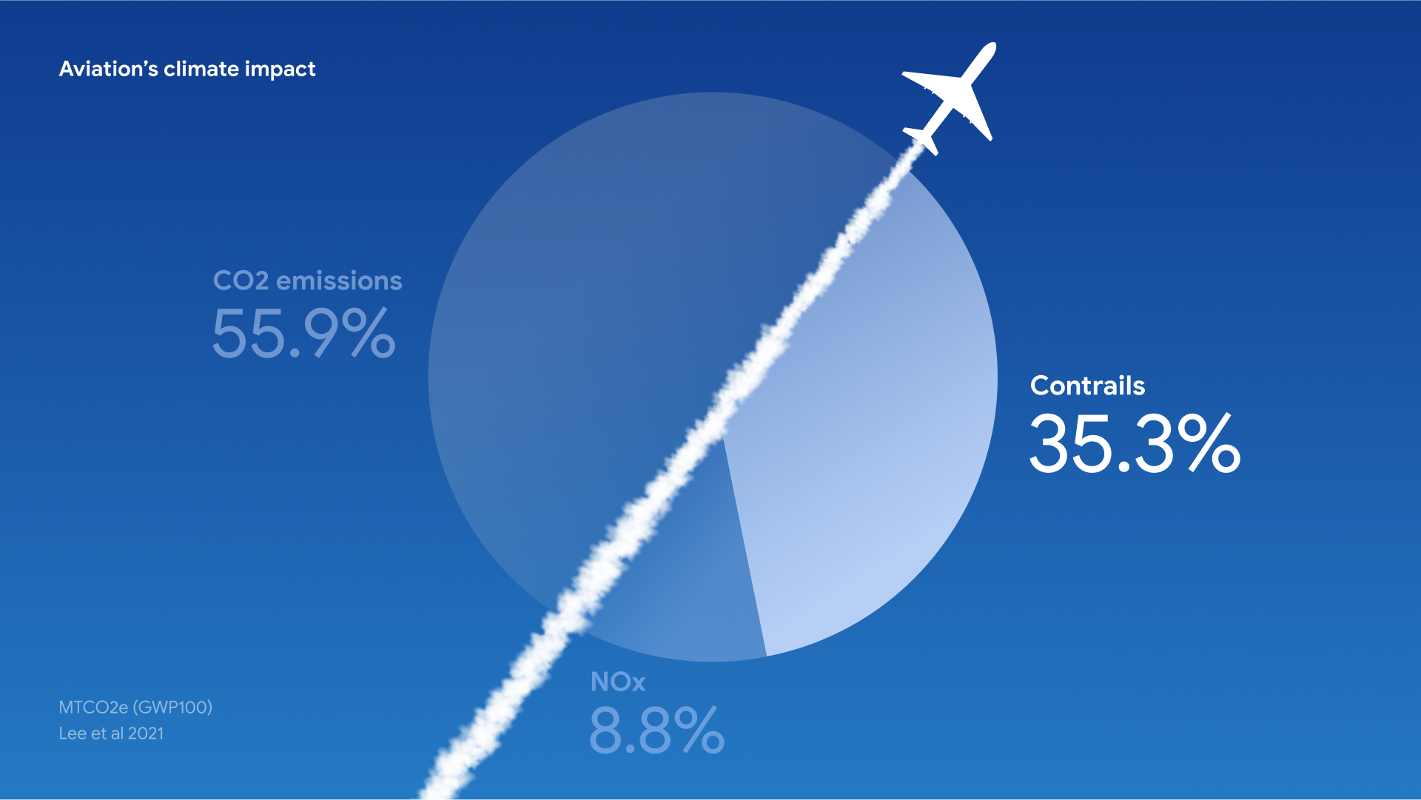

Slide 6
Problem Statement
Identify Contrails to Reduce Global Warming

Slide 7
Aim / Objective
Aim :
To help airlines avoid creating contrails and reduce their impact on climate change.
Objective :
Reduce Global Warming by eliminating Contrails

Slide 8
Application
To calculate Global warming, due to contrails produce by airplane
To calculate Emissions from airplane.
This will help airlines avoid creating contrails and reduce their impact on climate change.

Slide 9
Methodology

Slide 10
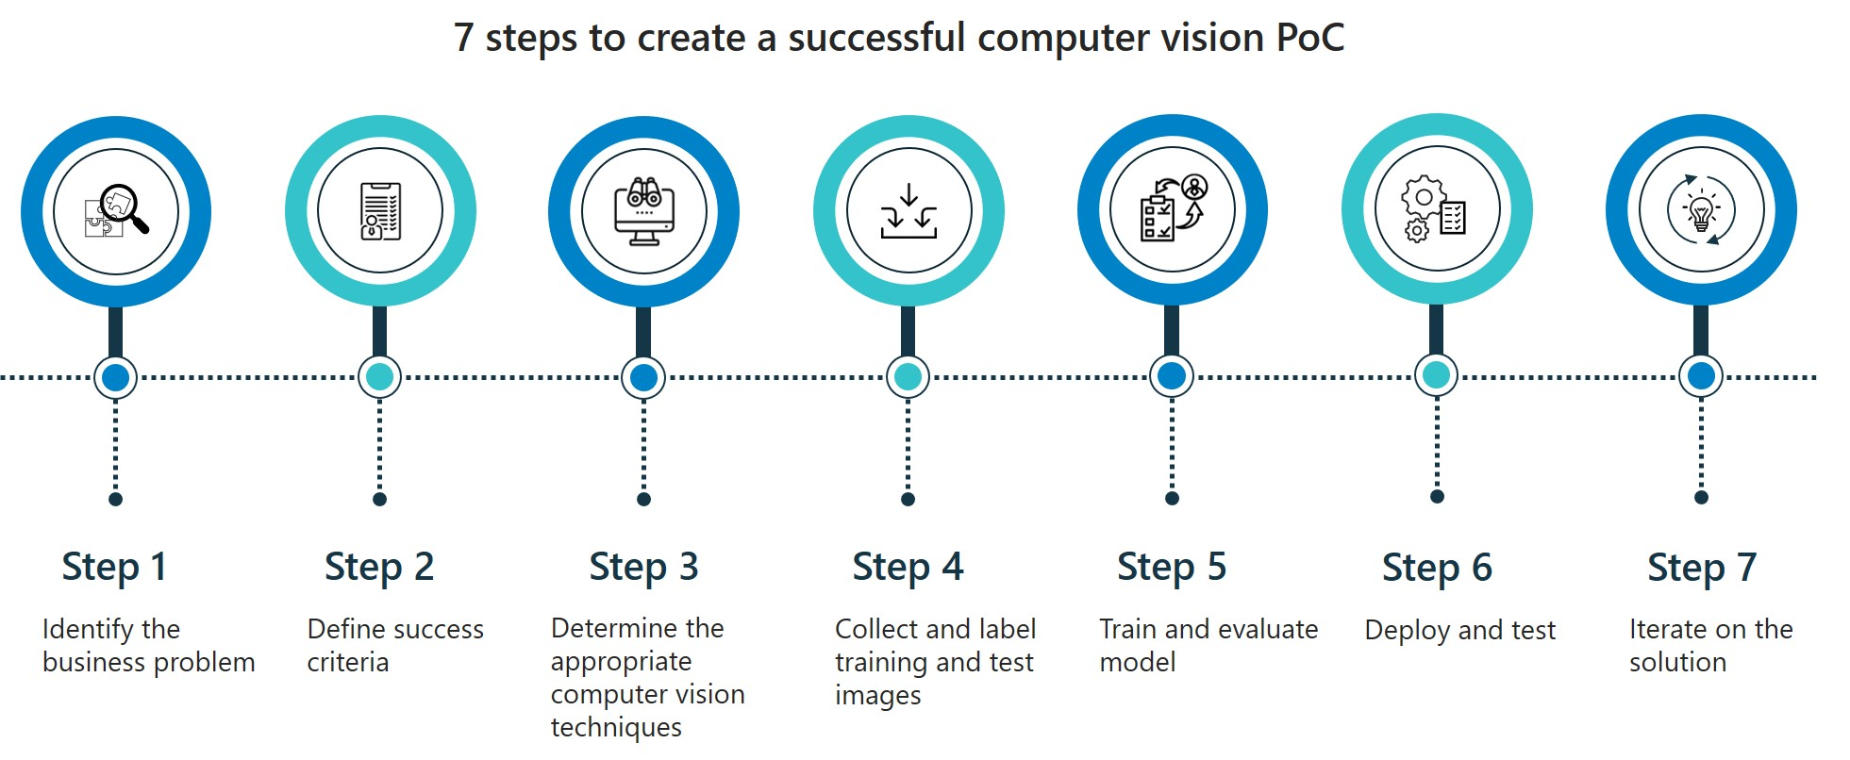

Slide 11
Dataset

Slide 12
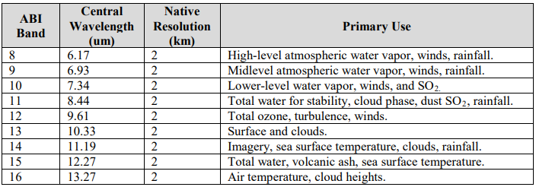
Data Contains

Slide 13
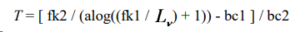
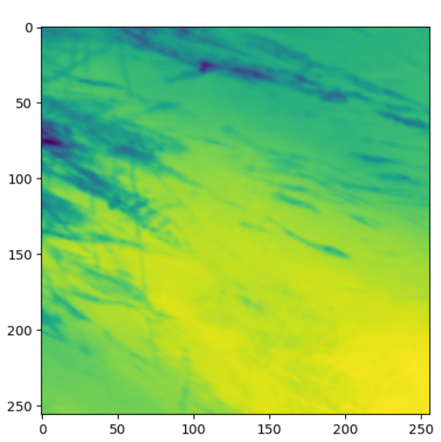
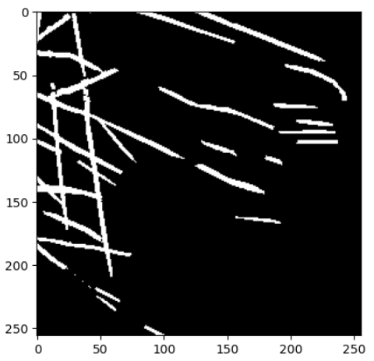
Sample Input and Output
fk1 and fk2 are coefficients of the Planck function derived from physical constants (i.e., the speed of light, the Boltzmann constant, and the Planck constant) and the bandpass central wavenumber, and bc1 and bc2 are the spectral response function offset and scale correction terms. These four coefficients are included in the product metadata as variables: “planck_fk1”, “planck_fk2”, “planck_bc1”, and “planck_bc2”.
Input
Output

Slide 14
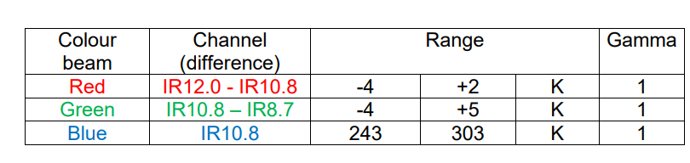
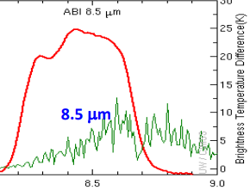
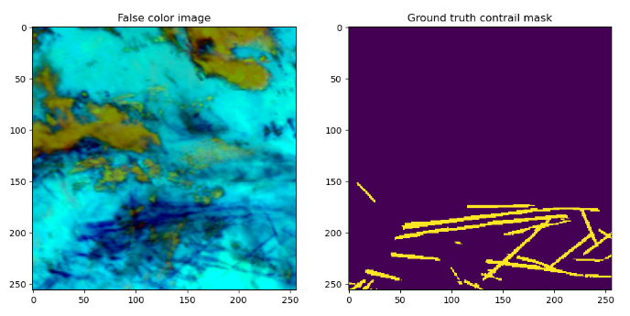
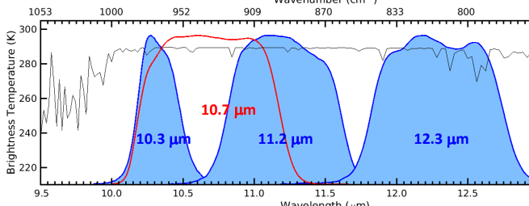
Convert Images to Ash Format

Slide 15
Deep Neural Network

Slide 16
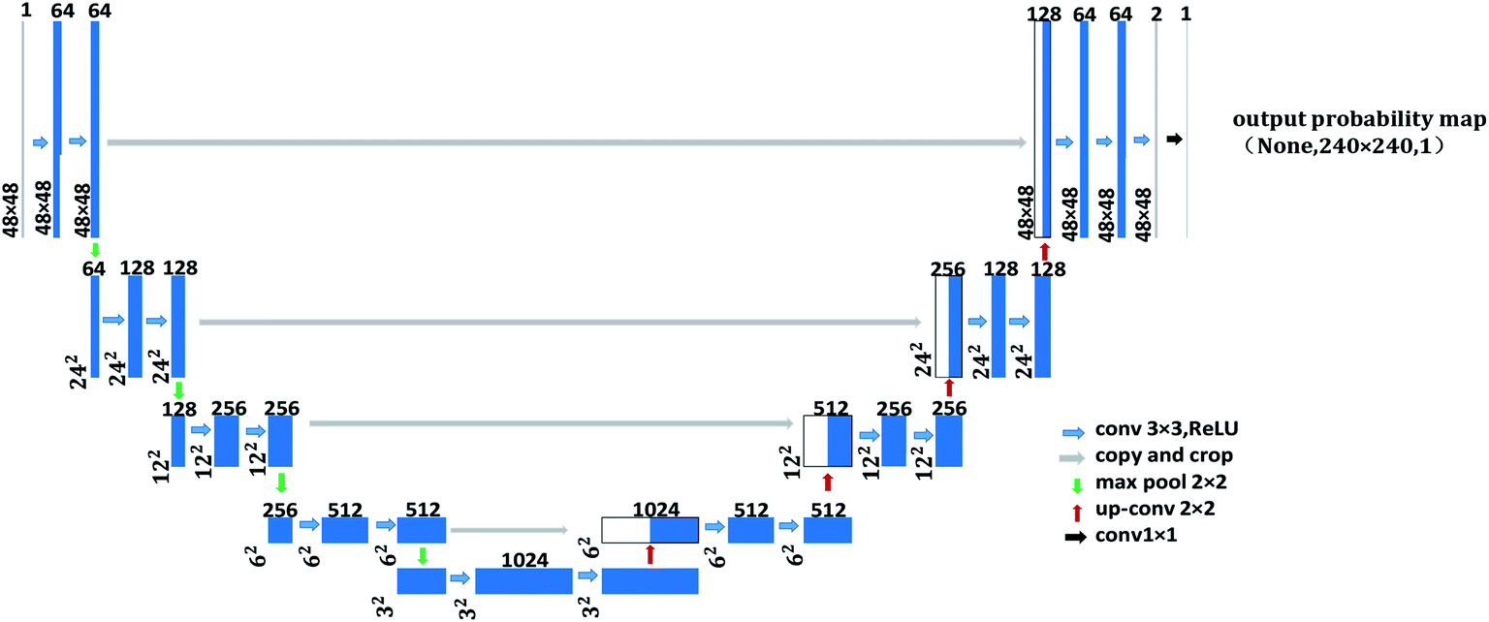
Architecture : U-Net
U-Net is an architecture for semantic segmentation

Slide 17
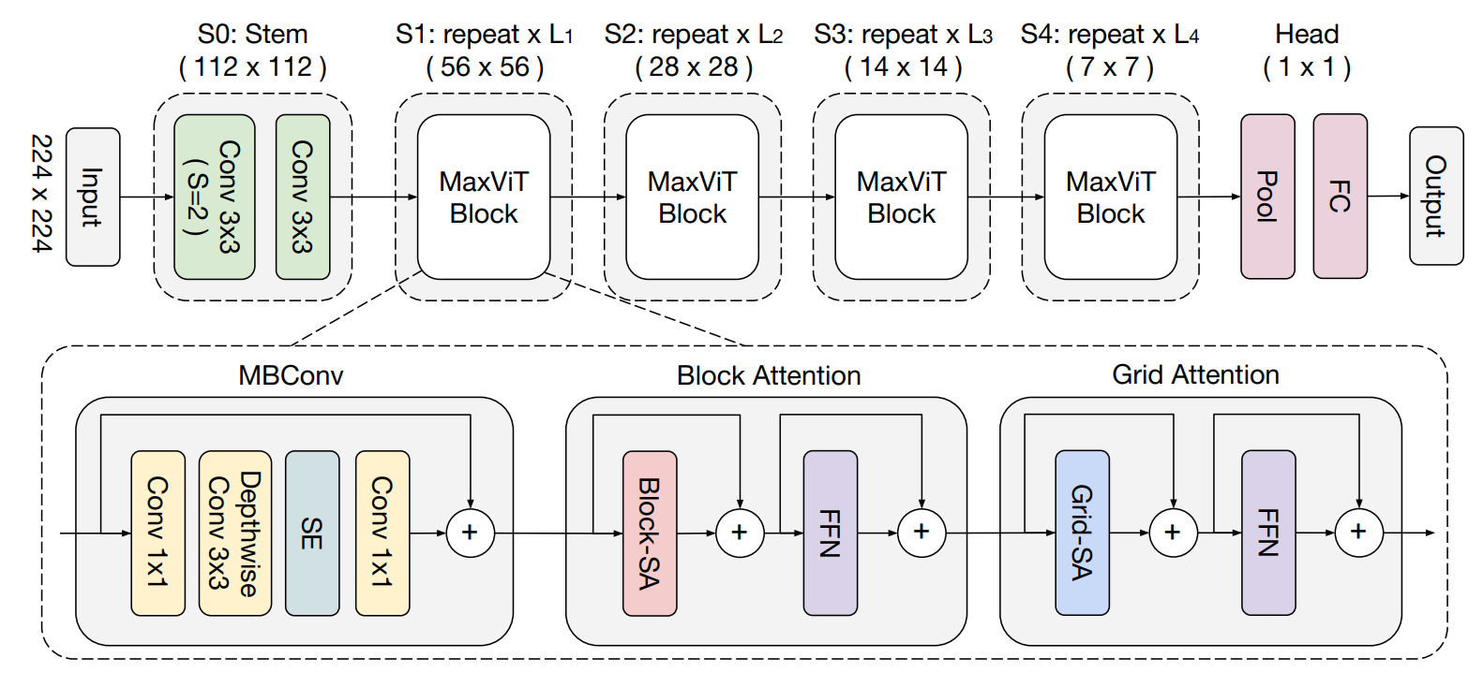
MaxViT: Multi-Axis Vision Transformer (ECCV 2022)
MaxViT is a family of hybrid (CNN + ViT) image classification models, it is developed by Google research Team

Slide 18
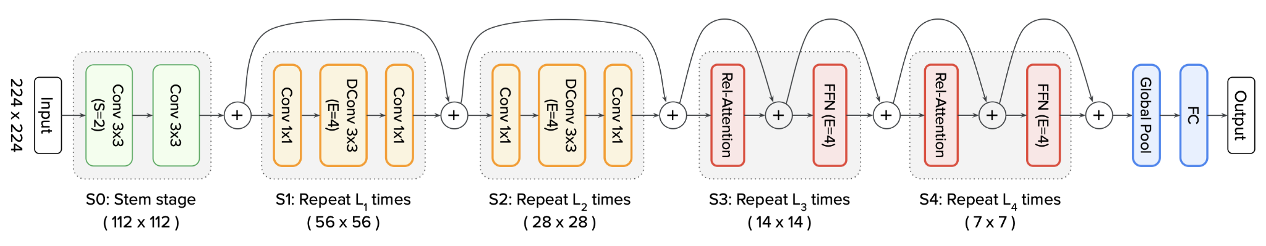
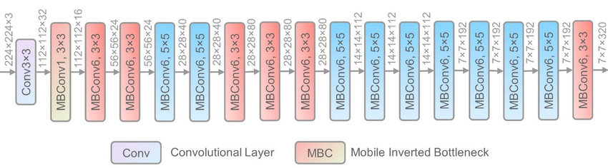
CoAtNet : Convolution and Attention
EfficientNet V2 : convolutional neural network and scaling method that uniformly scales all dimensions of depth/width/resolution using a compound coefficient.

Slide 19
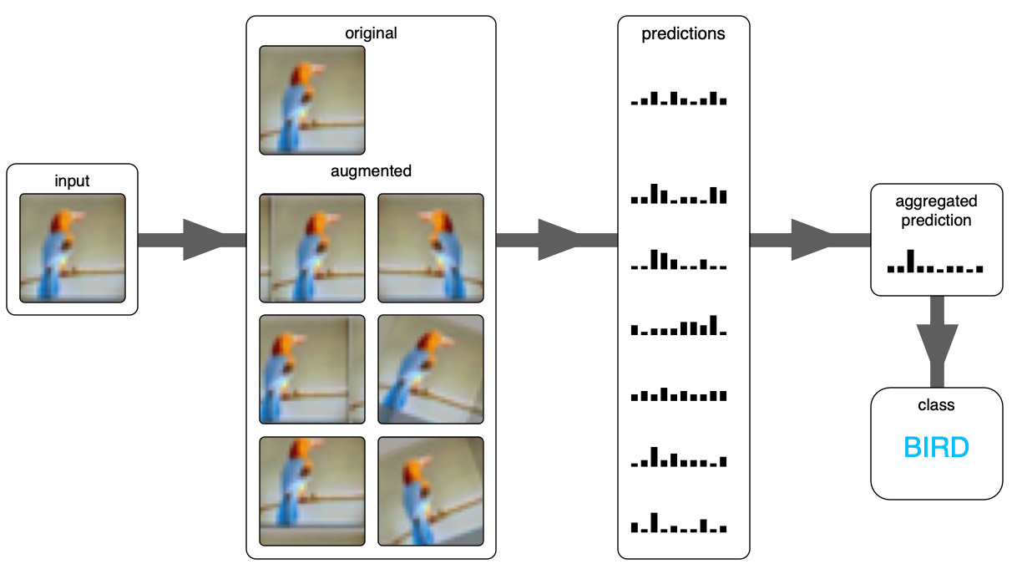
Test-time augmentation (TTA)

Slide 20
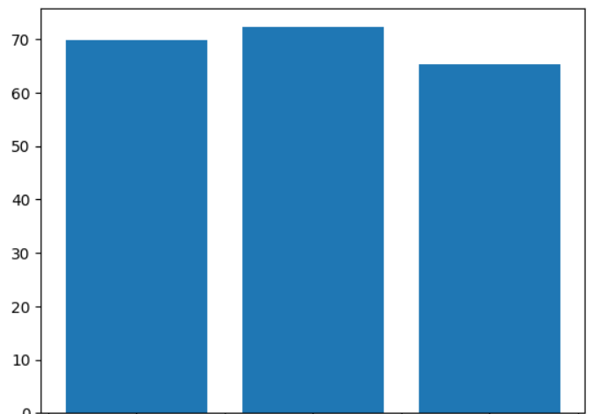
Results
Model | Accuracy
tu-maxvit_tiny_tf_512 | 72.2%
512-480-f5-efv2l-3d | 69.8%
CoAt_net-512-4 | 62.0%
Meijer et al | 71.6%
EffecientNet MaxVit CoAtNet

Slide 21
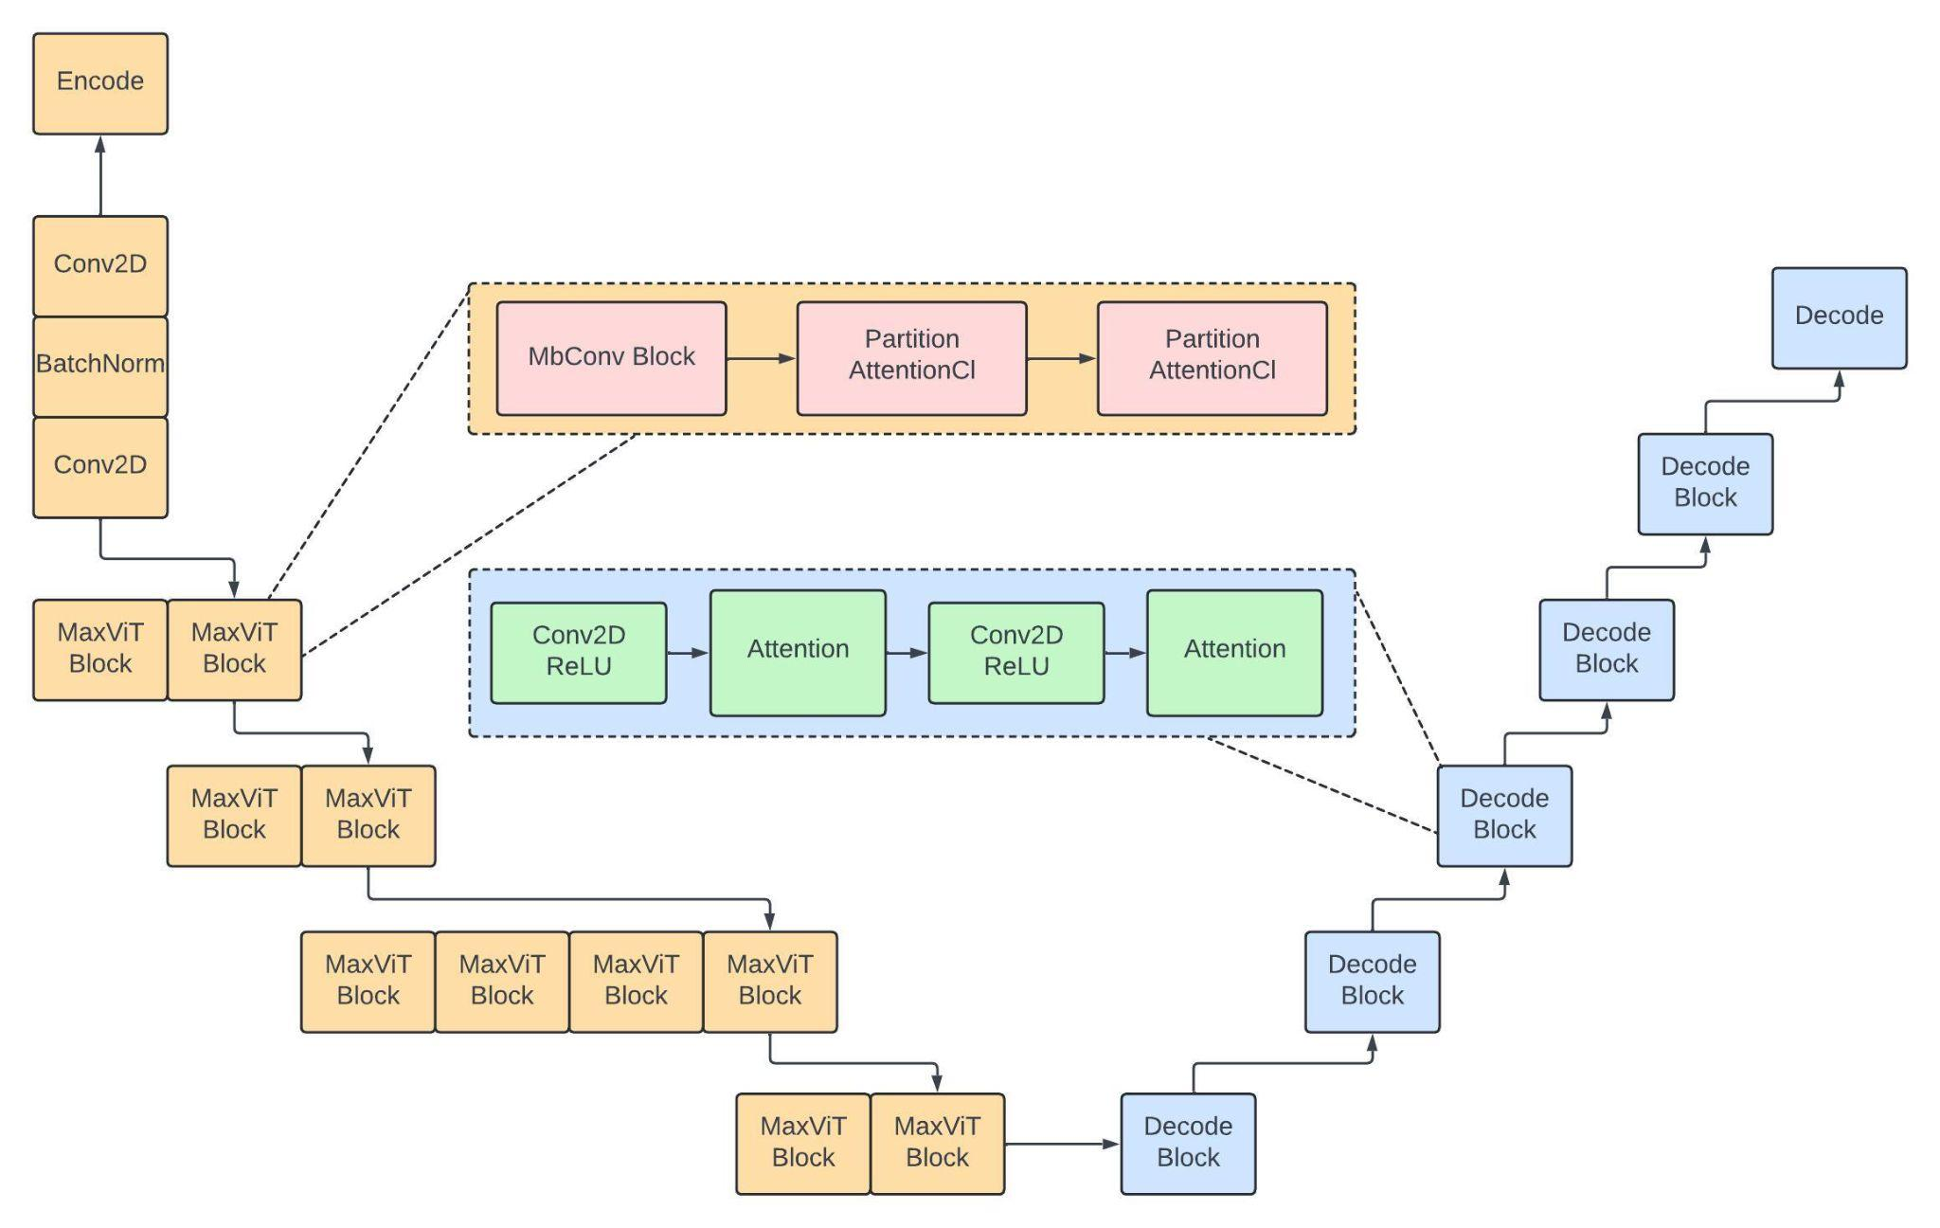
UNet with (tu-maxvit_tiny_tf_512)

Slide 22
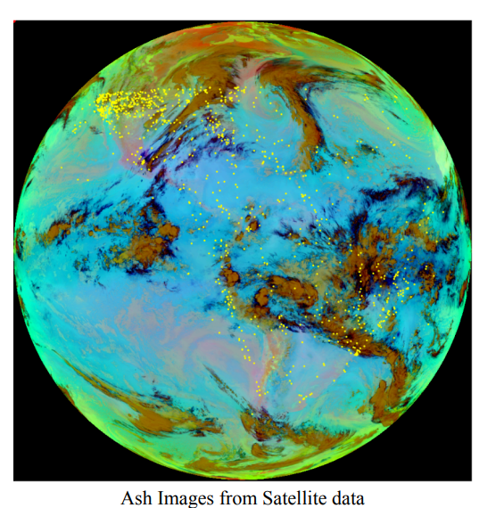
Coordinate Frame Conversion for Satellite Data Processing
Clarifies the transformation process from Longitude and Latitude coordinates to elevation and scanning angles, crucial for accurately projecting satellite imagery onto a two-dimensional plane.

Slide 23
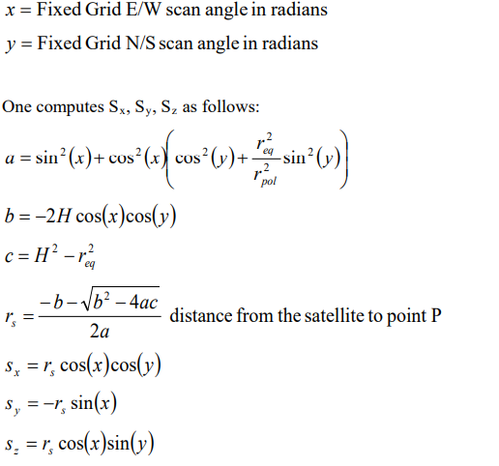
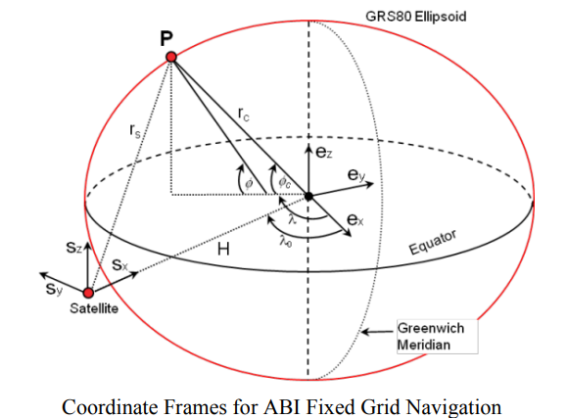
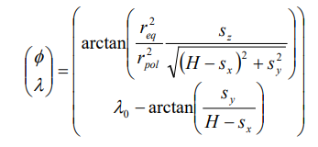
Conversion Formula

Slide 24
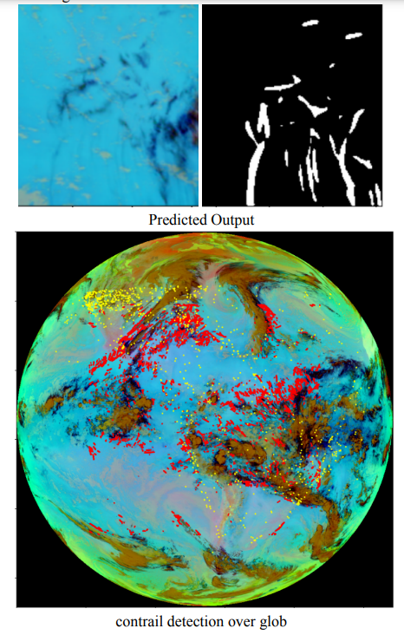
Processing and Stitching Ash Images from Satellite Data

Slide 25
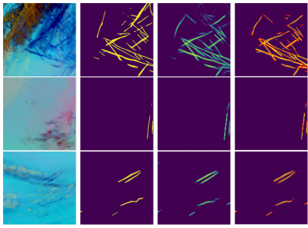
Compare Results
CoatNet EffNetV2 MaxVit

Slide 26
References
[1]:https://www.kaggle.com/competitions/google-research-identify-contrails-reduce-global-warming/overview
[2]:https://www.goes-r.gov/mission/ABI-bands-quick-info.html
[3]:https://arxiv.org/abs/2304.02122
[4]:https://www.goes-r.gov/spacesegment/abi.html
[5]:https://www.kaggle.com/competitions/google-research-identify-contrails-reduce-global-warming/discussion/430618
[6]:https://github.com/google-research/maxvit
[7]:https://arxiv.org/abs/2204.01697
[8]:https://arxiv.org/abs/2106.04803
[9]:https://arxiv.org/abs/1905.11946

Slide 27
Thank you

